Slide 1
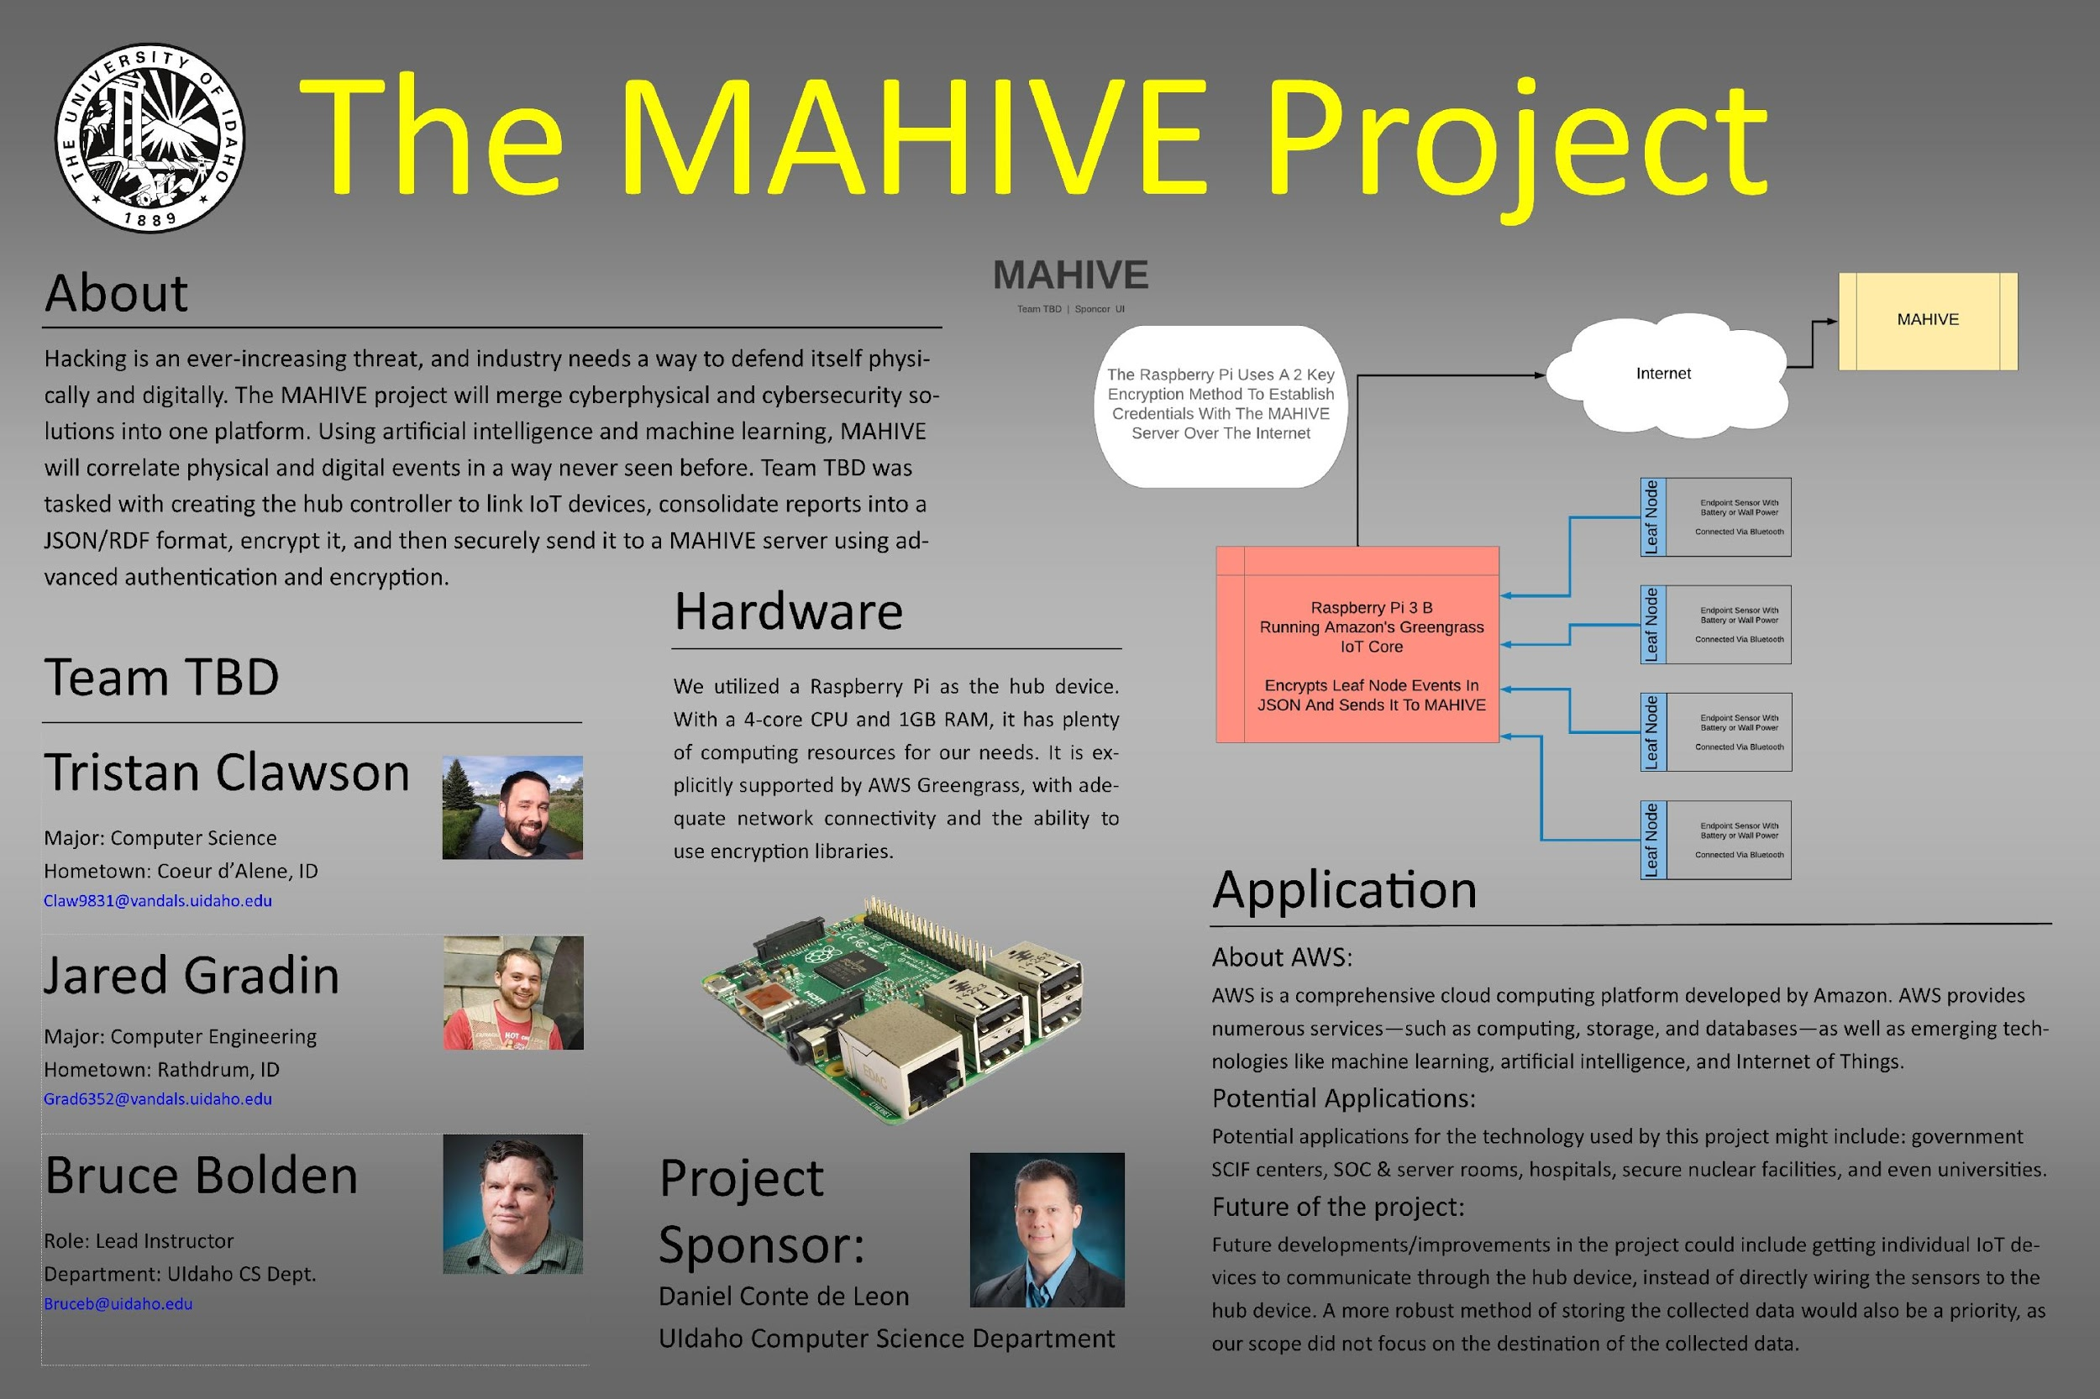

Slide 2
The MAHIVE Project
Building IoT Security

Slide 3
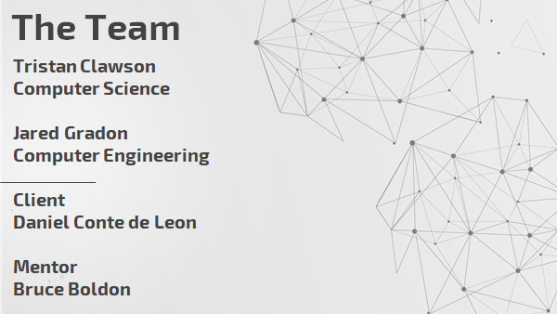
The Team

Slide 4
The Project
Correlate physical and digital events for total security
Focus on individual sensors which perform initial data collection
Hub device to relay sensor information to MAHIVE server
Modular system that can adapt to many situations or buildings

Slide 5
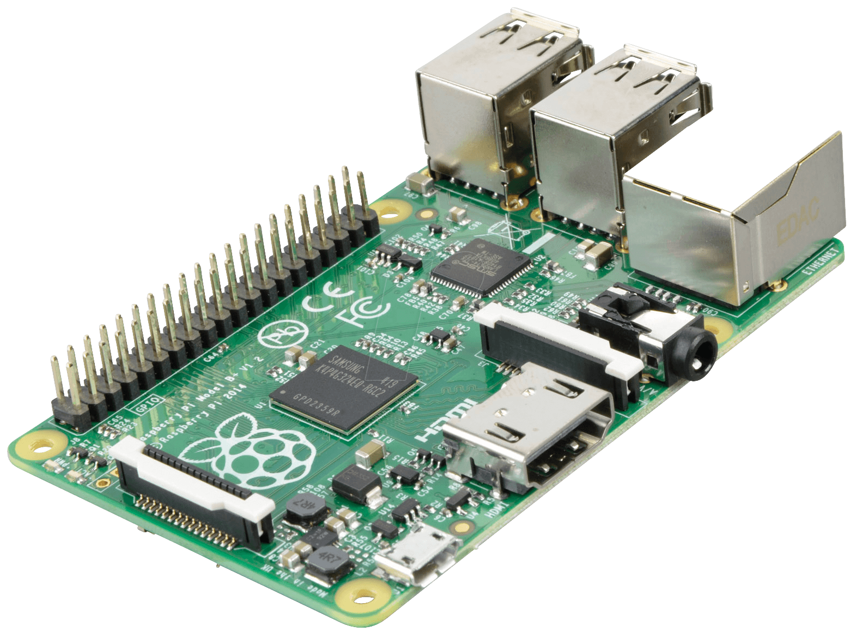
Project Objective
Authenticate to a cloud-based server using asymmetric encryption
Establish encrypted communication
Use JSON or TRDF to encode and send data
Prove this concept is viable

Slide 6
Value
Track both cyber and physical threats at the same time
Easily scalable
Easy to integrate into already existing environments

Slide 7
Expanded Value Proposition
Hacking ever-increasing threat; industry needs way to defend itself physically and digitally
Merge cyberphysical and cybersecurity solutions into one platform; correlate physical and digital events
Team TBD task: create hub controller to link IoT devices, consolidate reports into a JSON/RDF format, encrypt, securely send using advanced authentication and encryption

Slide 8
Customers
Who can use this?
Government SCIF centers
SOC and Server room
Hospitals, Prisons, and Military Bases
Secure nuclear facilities
INL, PNNL, Hanford, and more

Slide 9
Design Constraints
Design must be low-cost
No elaborate, costly solutions (goal for sensors: <$50)
Design must use off-the-shelf parts/boards
Raspberry Pi, etc.
Use simple sensory parts readily available online
Sensors should be able to run off battery power
Board should have low power consumption
Interrupts rather than polling
Sensor device should be small & easily placed inside building

Slide 10

SCADA By Design
Supervisory Control And Data Acquisition
A Traditional System Spans A Large Area
Our System Is Designed With Security In Mind

Slide 11
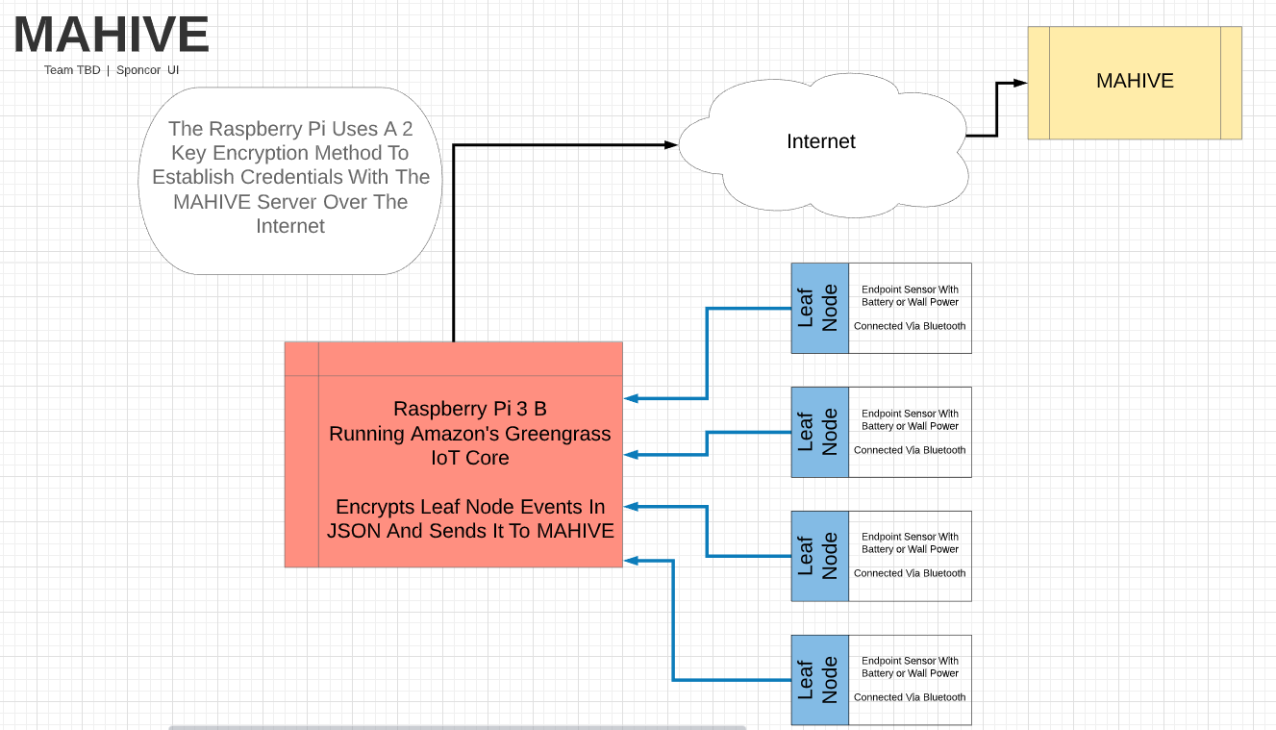
Flow Diagram

Slide 12
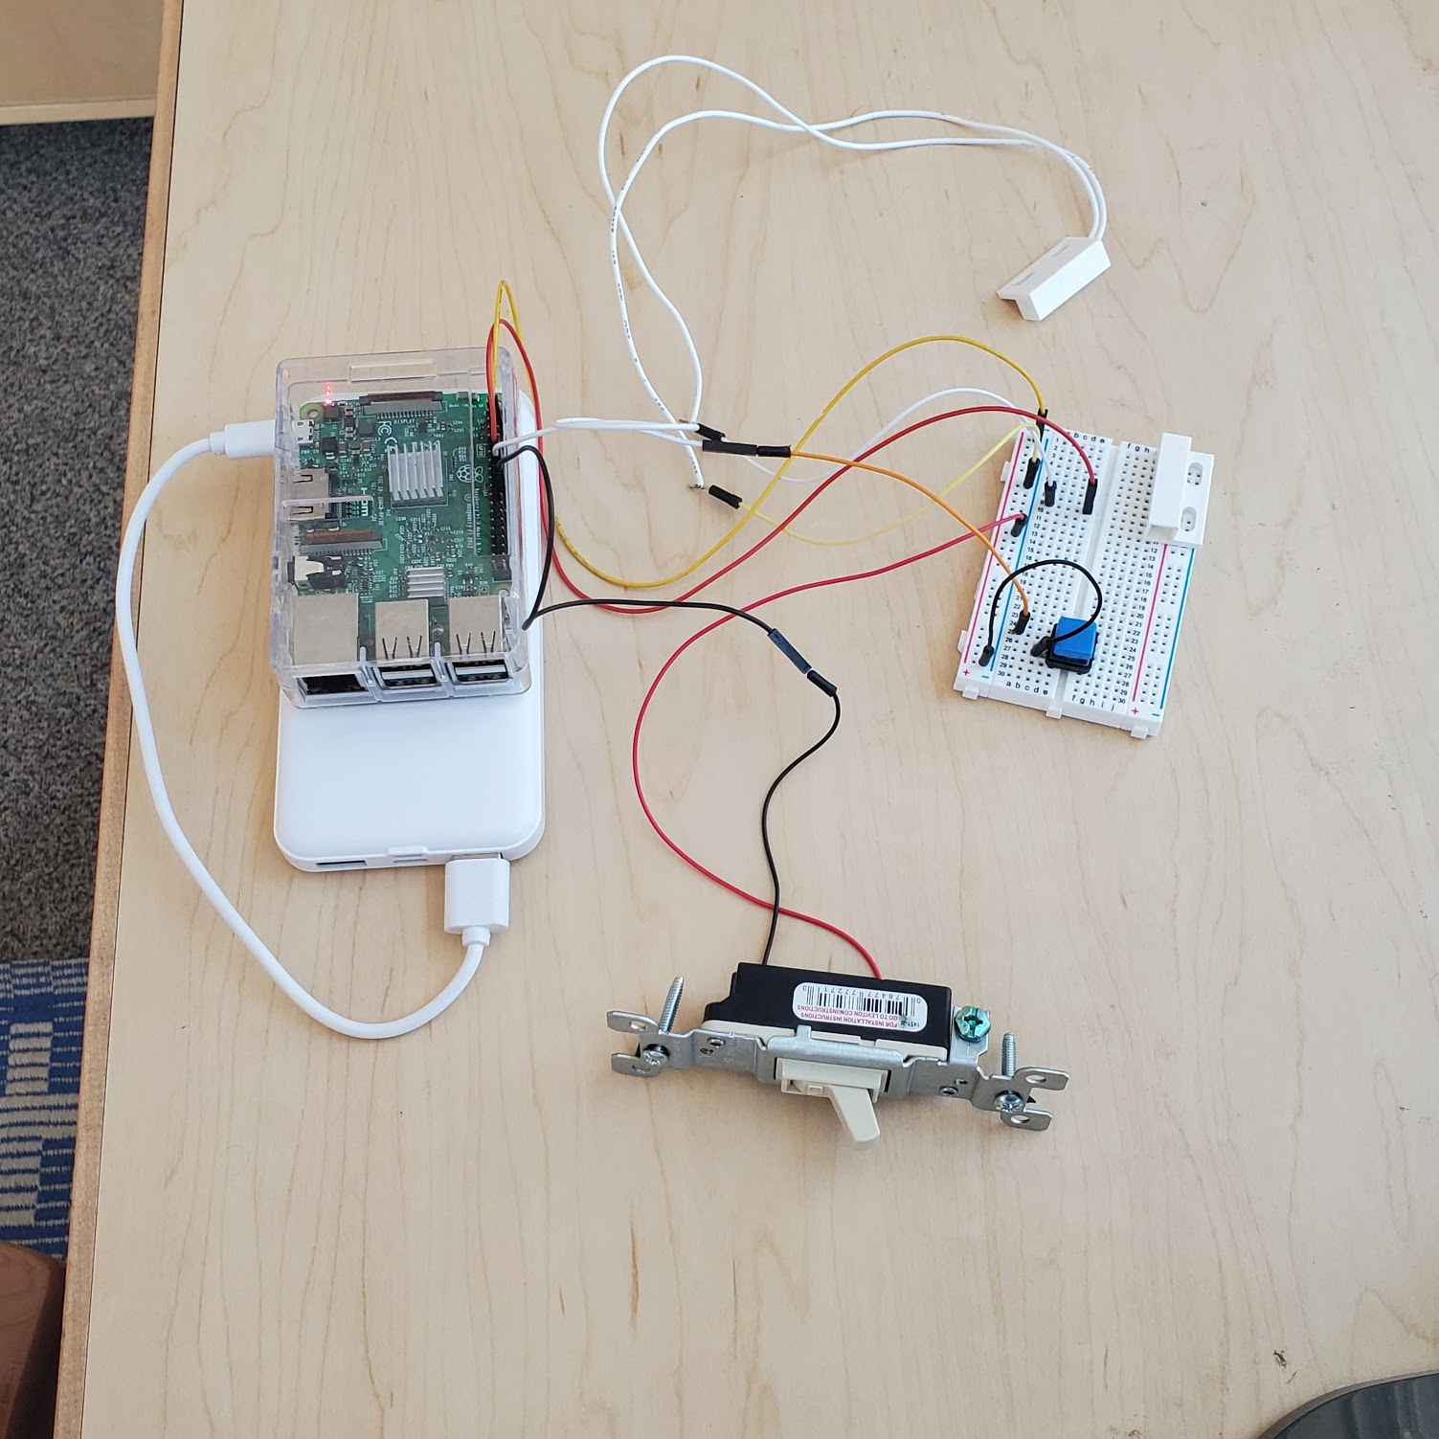
Tech Demo
2a.
Demo Setup:
Hub device (Raspberry Pi)
Mock Sensors
Door Sensor
Light Switch
Battery Pack (Mock Power Source)
Kill Switch (Reset Button)
1.
4.
3.
2b.

Slide 13
What We Learned
I can handle anything if I just stop and reevaluate
The project requirements are so much more than the project
AWS platform possible viable option, provided can be used in an educational context
AWS not hard to learn or use, but tricky to get running perfectly
Lots of functionality, but not as user friendly

Slide 14
THANK YOU
Does anyone have any questions?

Slide 15

Thank You

